Slide 1

SOFTWARE ENGINEERING PROJECT
Welcome to the Presentation
of Our Project
Intelligent House System for Smart Lighting
and AI-Powered Security Monitoring
VIGILIS

Slide 2


REPUBLIC OF CAMEROUN
Paix-Travail-Patrie
AFRICAN INSTITUT OF COMPUTER SCIENCES PAUL BIYA UNNIVERSITY CENTER OF EXCELLENCE YAOUNDE
Tel: (237) 22 72 99 57
Site Web: www.iaicameroun.com
REPUBLIC OFCAMEROON
Paix-Travail-Patrie
PROJECT PRESENTATION
THEME:
Design and Implementation of an Intelligent House System Based on Light Intensity Control and Security Monitoring.
Software Engineering Project
In view of obtaining a Higher Technician Diploma (HTD) in Computer Sciences.
Option: Software Engineering
Presented By:
YOGO JEAN ARIEL LEPRECIEUX
Academic Supervisor
Mr. TCHOUA
Lecturer at AICS
Professional Supervisor
Mr TCHOUA NANA
CEO OF INTERLINK
ACADEMIC YEAR 2025 – 2026

Slide 3
Plan of Work
Introduction
Context & Problematic
01
02
Proposed Solution
Methodology
03
04
Demonstration
Conclusion & Perspectives
05
06
VIGILIS
03

Slide 4

01 — INTRODUCTION
From Manual Homes
to Intelligent Living
VIGILIS
04

Slide 5
02
CONTEXT & PROBLEMATIC
From manual control to an intelligent, proactive home.

Slide 6


CONTEXT
Where Today's Homes Fall Short
Security
Energy
Access
Manual monitoring
Delayed detection
No intelligent verification
Manual lighting
Unnecessary consumption
No automatic brightness
Fragmented devices
Limited remote control
No unified platform
VIGILIS
06

Slide 7

PROBLEMATIC
How can a residential environment improve security, lighting efficiency and emergency response by integrating IoT devices, AI-powered threat analysis, facial recognition and a centralized mobile application?
07

Slide 8




3 PROPOSED SOLUTION
VIGILIS — Intelligent House System
Sense
Analyze
Decide
Respond
Sense → Analyze → Decide → Respond
VIGILIS
08

Slide 9






PROPOSED SOLUTION
Core Functionalities
Smart Lighting
Facial Recognition
Motion Detection
Automatic ON/OFF and brightness adjustment
Identify or verify authorized persons
Detect movement through connected sensors
AI Threat Analysis
Remote Monitoring
Emergency Response
Evaluate events and identify genuine threats
View security status, cameras and events
Notify the appropriate security service when confirmed
VIGILIS
09

Slide 10
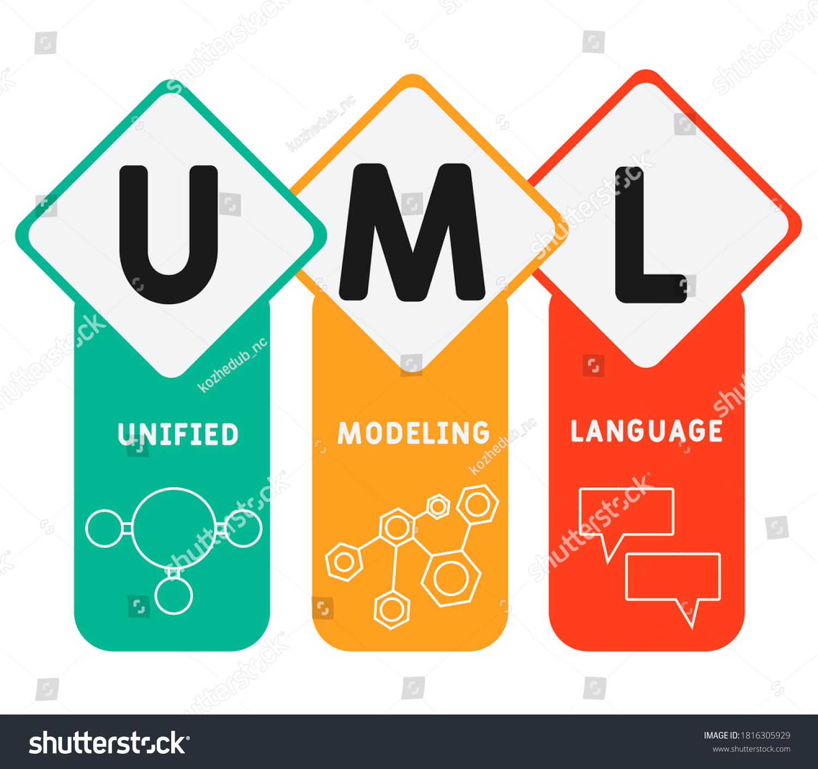
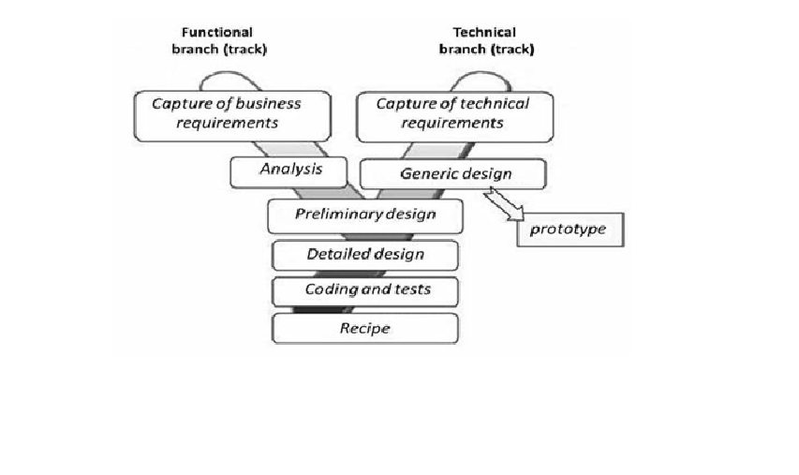
4 METHODOLOGY
+
11

Slide 11
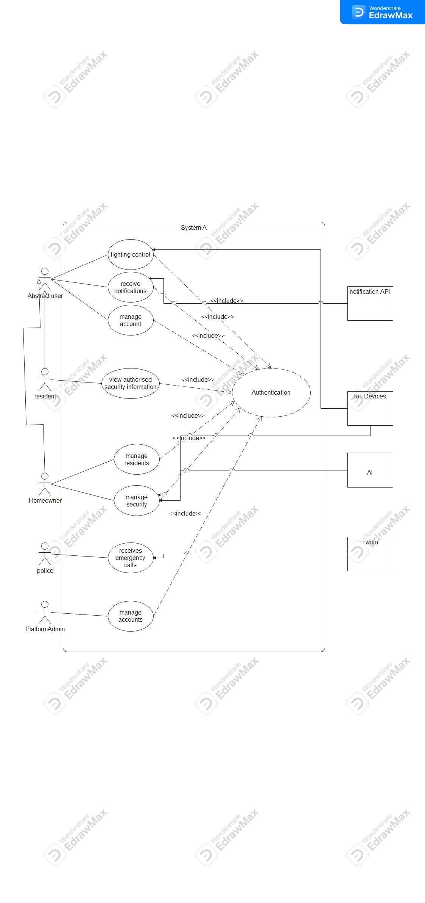
UML & ARCHITECTURE
General Use Case
VIGILIS
12

Slide 12
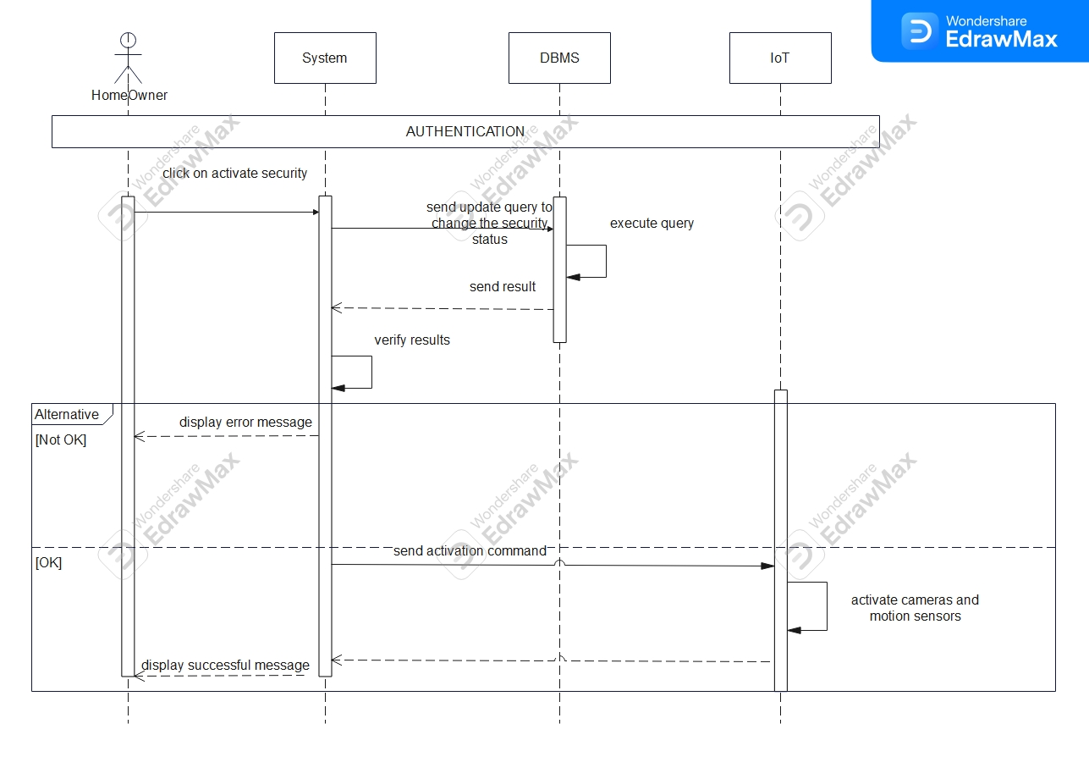
UML & ARCHITECTURE
Sequence Diagram
13

Slide 13
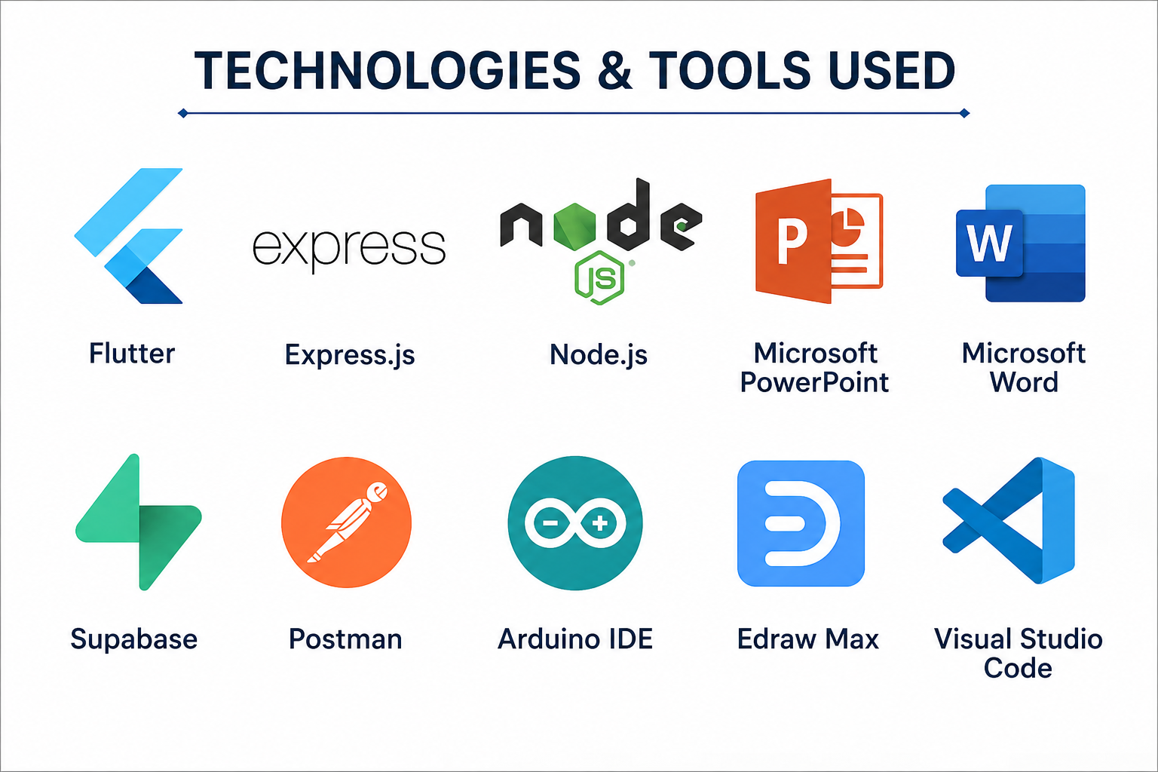
ARCHITECTURE
VIGILIS
14

Slide 14
ARCHITECTURE
Logical Architecture
MVVM
Flutter App
Express.js API
Sequelize
MySQL
(View + ViewModel)
( Logic)
ORM
(XAMPP)
AI / Security Services
Face + object + threat analysis
IoT Device Layer
ESP32 · Sensors · Lights · Camera
VIGILIS
15

Slide 15






ARCHITECTURE
Physical Architecture
Homeowner / Resident
Flutter
Express.js
Security Service /
Mobile App
Server
Police
AI Analysis
MySQL
Service
Database
ESP32 / ESP32-CAM
Sensors · Camera · Lights
Each house is isolated by house ID / authorization rules to prevent cross-house device access.
16

Slide 16
05 — DEMONSTRATION
17

Slide 17
06 — CONCLUSION & PERSPECTIVES
A house that senses.
A system that understands.
A response that acts.
VIGILIS brings together IoT, AI, smart lighting, secure access and emergency response to create a safer, smarter and more responsive home.
VIGILIS
18

